Slide 1
Mobile Banking App
Name: Abhijeet Kumar Gaur
GID::338358
Contact:7660838822
E-mail : abhijeetkumar.gaur@techmahindra.com

Slide 2
Login Page

Slide 3
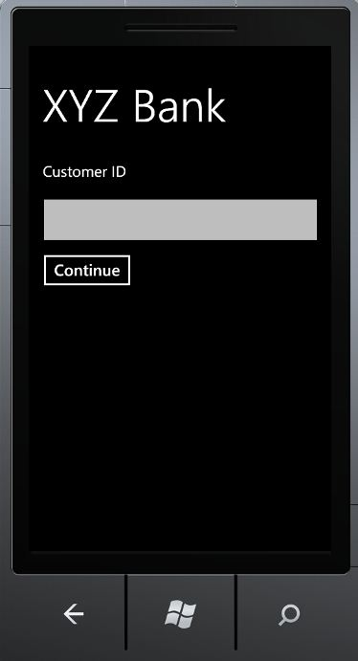
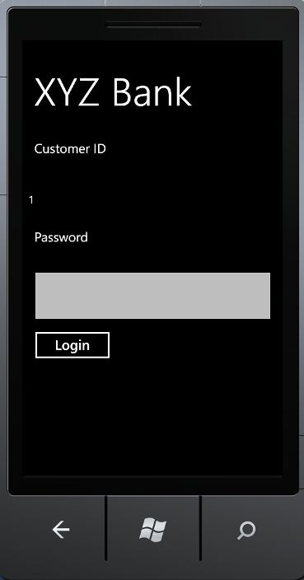
1. Enter customer id
2. After accepting customer id prompts for password

Slide 4
Super User Account (For Administration of app)

Slide 5
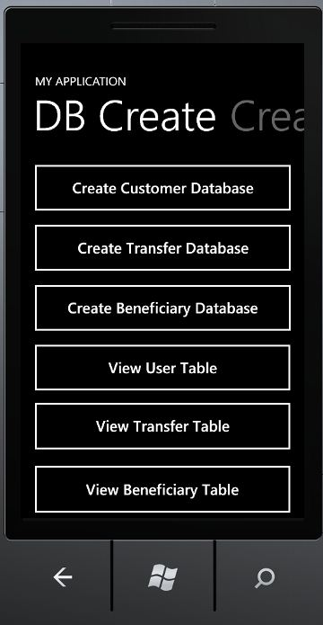
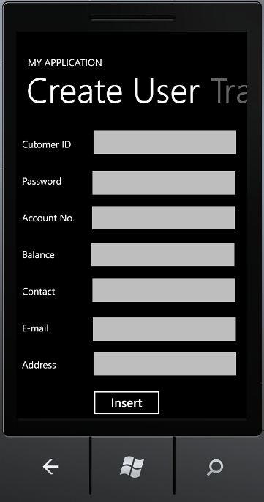
1. Creating isolated storage for data and viewing tables of storage
2. For inserting dummy user account

Slide 6
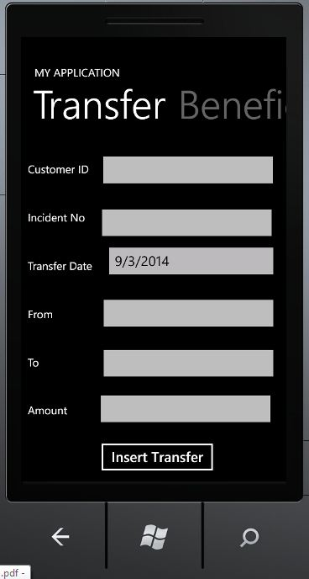
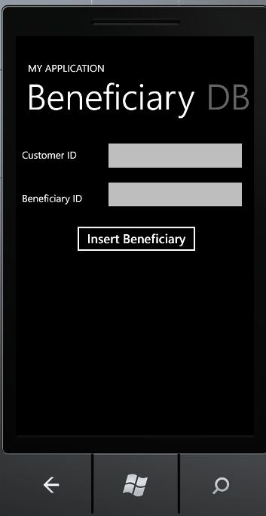
3. Creating dummy transfer data
4. Creating dummy beneficiary data

Slide 7
User (For app users)

Slide 8
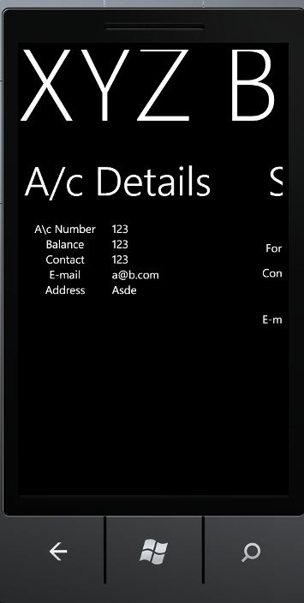
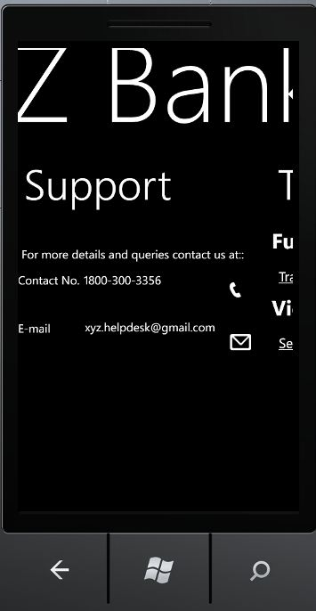
2. Support Page for help
1. Displays User bank details

Slide 9
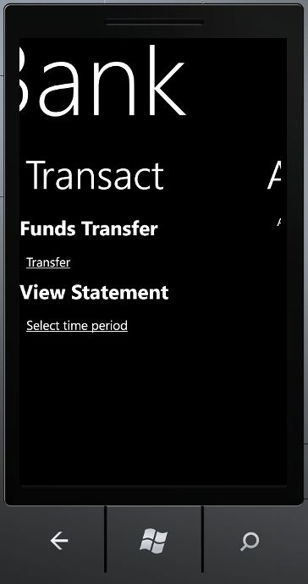
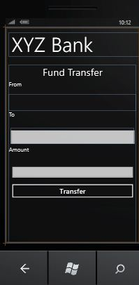
3. Transaction Page
4. Funds Transfer

Slide 10
Technologies Used
1. XAML
2.Silverlight
3.C#
4.Isolated Storage
5.Linq

Slide 11
SDK
1. Visual Studio for Windows Phone

